Slide 1





Calories PRediction
Using
Machine Learning
Name: Ajoob Sagar Kansakar
London MetID: 23056153
Module: CU6051NI | Artificial Intelligence

Slide 2


Topic Overview
Ai Concepts Used
Research Evidences
Reason for TOpic Selection
Proposed Solution
Application Workflow
Pseudocode
Flowchart
Real-world Problem solved
Achieved Results
Conclusion
Agendas:

Slide 3


Topic Overview
This Project focuses on predicting the calorie content of food items using nutritional information
Calories are estimated using machine learning regression techniques
Nutritional attributes such as carbohydrates, protein, fat, sugar, and fibre are used as input features
Goal is to compare multiple regression models and identify the best-performing approach.

Slide 4





AI Concepts Used
Artificial Intelligence concept used: Machine Learning
Learning type: Supervised Learning
Problem type: Regression
Linear Regression
Decision Tree Regressor
Random Forest Regressor

Slide 5

Research
Evidence
Previous studies show machine learning is effective in nutrition analysis
Regression models are used widely for calorie and nutrient prediction.
Random forest models are proven to handle non-linear data effectively.
Research supports use of ensemble models for improved accuracy.

Slide 6


WHy Calorie Estimation?
Manual calorie calculation is time-consuming and error-prone.
Many users reply on food lables without understanding calorie compositon.
Machine learning provides an automated and scalable solution.
Calorie tracking is essential for:
Health monitoring
Diet planning
Weight management
To simplify calorie estimation using AI-based prediction model the following project was implemented

Slide 7
Proposed
Machine learning
solution
Load Dataset
Preprocess
data
Train
Model
Use nutritional attributes as input features
Train regression models to learn calorie patterns
Compare model performance using evaluation metrics
Select best-performing model for prediction
Evaluate
results
Predict calories
for
user input

Slide 8
Application Working Process
User enters nutritional values per 100g of food
System process the input data
Trained machine learning models predict calorie values
Output displays:
Standard calorie formula result
ML model-based calorie prediction
User Input
Intelligent prediction
Prediction results

Slide 9
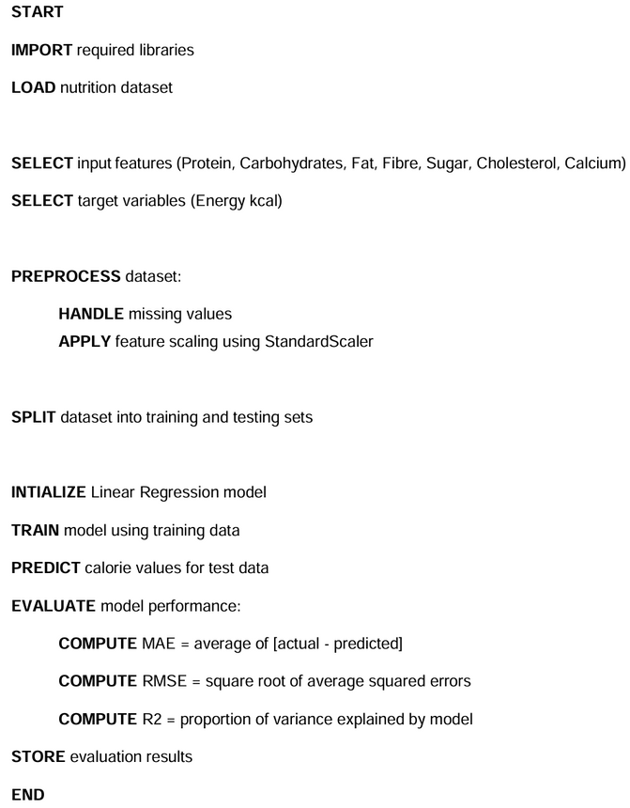
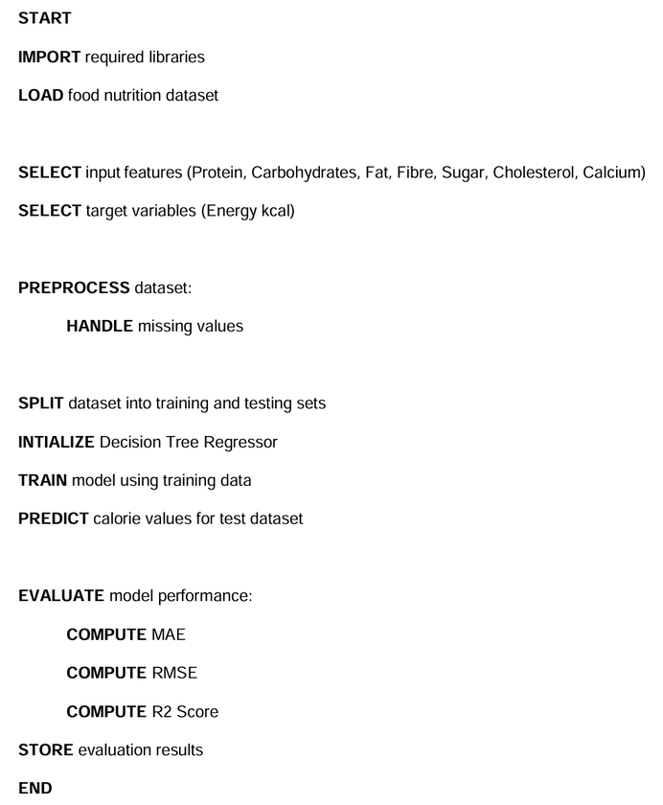
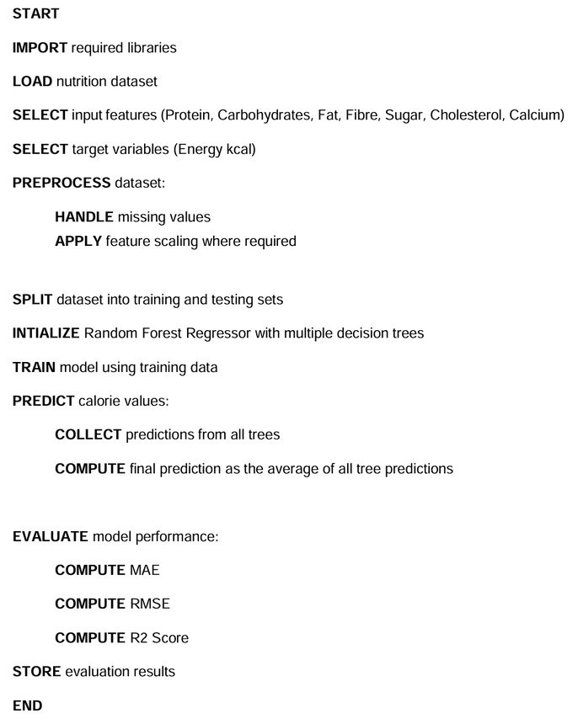
Pseudocode Summary
Linear Regression
Decision Tree
Random Forest

Slide 10
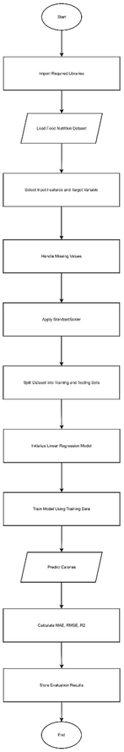
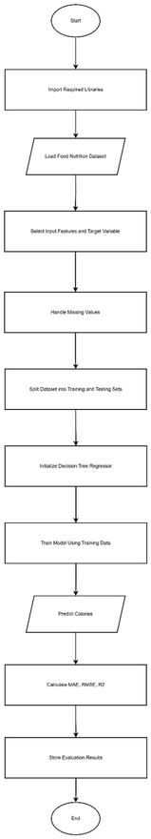
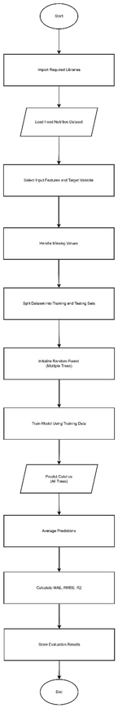
Flowchart overview
Linear Regression
Decision Tree
Random Forest

Slide 11
Real-world application
Helps user estimate calories without manual calculations
Useful for:
Fitness applications
Diet tracking systems
Health monitoring tools

Slide 12


achieved Results
Models evaluated using:
Mean Absolute Error (MAE)
Root Mean Squared Error (RMSE)
R2 Score
Random Forest achieved the highest accuracy.
High R2 scores indicate strong prediction capability.
Minimal difference between training and testing performance.

Slide 13
Conclusion
Machine Learning models successfully predicted calorie values.
Ensemble models performed better than simple regression.
System demonstrates practical AI Application in nutrition analysis.

